Slide 1

HUMAN–AUTONOMY SHARED CONTROL FOR UAV OBSTACLE AVOIDANCE
CD6
Iniya M - CB.SC.U4AIE24219
P. POORNIMA - CB.SC.U4AIE24343
SOWMYA A - CB.SC.U4AIE24357
Y. LIKITHA REDDY - CB.SC.U4AIE24361

Slide 2


INTRODUCTION
Unmanned Aerial Vehicles (UAVs) are increasingly used in environments where safe and reliable navigation is essential.
Fully autonomous UAV operation can be challenging in dynamic or uncertain environments.
Human operators provide flexibility and decision-making capability during flight.
However, continuous manual control can lead to delayed reactions when obstacles appear suddenly.
Shared control combines human control with autonomous safety assistance.
In the proposed system, the UAV remains under human control during normal flight.
When a critical obstacle is detected, the autonomous controller temporarily takes over to perform safe avoidance.
After the obstacle is cleared and the UAV stabilizes, control is returned to the human operator.
The system is implemented and evaluated using the GymPyBullet simulation environment.

Slide 3
PROBLEM STATEMENT
1) Manual UAV operation provides human flexibility but depends heavily on the operator's reaction time.
2) When the pilot commands the UAV toward an obstacle, continuing the same command may result in collision.
3) A completely autonomous controller, on the other hand, removes the human operator from normal decision-making.
4) Therefore, there is a need forring safe flight,
continuously monitors obstacle risk,
detects critical situations,
temporarily overrides unsafe forward motion,
performs obstacle avoidance,
and automatically returns control to the human.
5) The challenge is to achieve this intervention without causing abrupt or unsafe autonomous movements.

Slide 4
OBJECTIVES
Develop a UAV environment for human-controlled flight.
Continuously monitor the UAV's surrounding environment.
Identify obstacles that threaten the UAV's intended flight path.
Determine when human control may result in collision.
Automatically activate autonomous safety assistance during critical situations.
Select a safe direction for obstacle avoidance.
Execute a local collision-free avoidance maneuver.
Maintain stable UAV motion during autonomous intervention.
Return control to the human operator after the obstacle is cleared.
Evaluate the effectiveness and safety of the proposed shared-control mechanism.

Slide 5
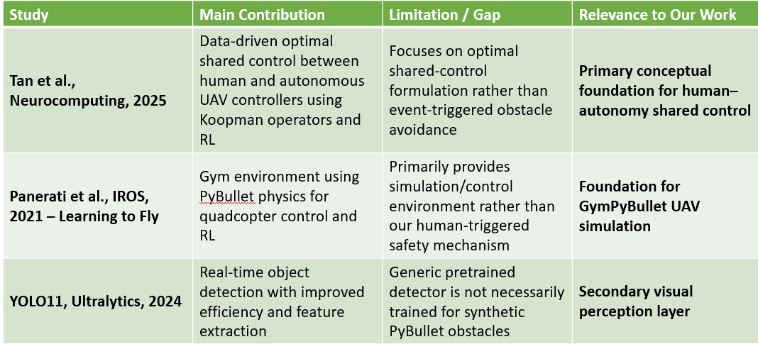
LITERATURE REVIEW

Slide 6
METHODOLOGY
1) UAV Initialization and Manual Flight
A Crazyflie 2.x (CF2X) UAV is initialized in the GymPyBullet environment.
The UAV is controlled using a PID-based position controller.
The human operator provides the flight commands.
During normal operation, the UAV remains in MANUAL mode.
2) Obstacle Monitoring and Risk Assessment
The simulated environment is continuously examined for obstacles.
The system evaluates whether an obstacle lies within the UAV's forward flight corridor.
The UAV safety margin is considered when determining collision risk.
The system distinguishes between a safe situation and a potentially dangerous obstacle encounter.

Slide 7
METHODOLOGY
3) Event-Triggered Autonomous Takeover
If no critical obstacle is present:
Human control continues.
If a critical obstacle is detected while the UAV is moving toward it:
Autonomous safety control is activated.
4) Local Obstacle-Avoidance Planning
After takeover:
Forward motion is reduced/stopped.
Available clearance on the left and right sides of the obstacle is evaluated.
The safer direction is selected.
A local avoidance path is generated.
Candidate path segments are checked for collision safety.

Slide 8
METHODOLOGY
5) Autonomous Avoidance Execution
The UAV follows the selected local avoidance path using the PID controller.
Autonomous target movements are constrained to avoid abrupt changes.
The obstacle is continuously monitored during the maneuver.
If the planned path is unsafe, the system can reject/replan.
6) Stabilization and Control Handoff
After the obstacle has been cleared:
The UAV moves to a safe region.
UAV motion is stabilized.
The system verifies that the obstacle no longer represents an immediate threat.
Autonomous intervention is terminated.
Control authority is returned to the human operator.

Slide 9
THANK YOU

